Slide 1

Capstone Presentation
INTMINDS: A BYTE PER MEMBER

Slide 2

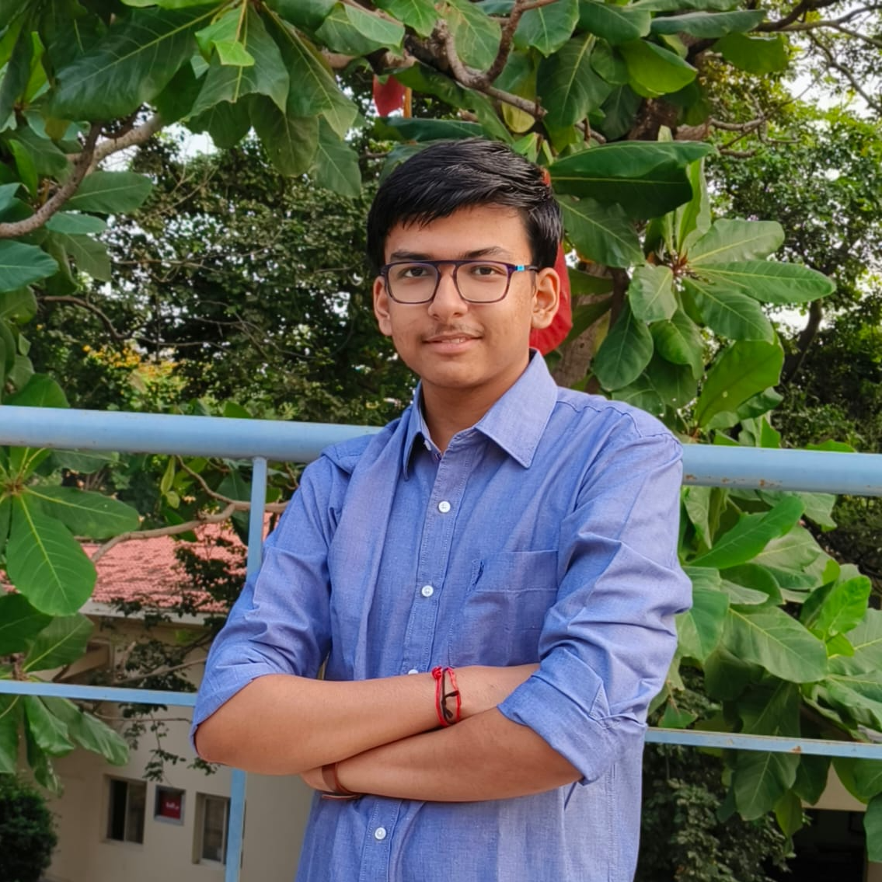


The Team.
Modi Gautam
Patel Jainil
Gaadhe Jayansh
Somaliya Vatsal
202301214
202301205
202301232
202301210

Slide 3
Abstract
This Presentation discusses the algorithm and analysis of the P1: Time table Generator assigned to us.
This project requires us to generate time table of the courses running in our college.
We are given with the input csv file and need to generate time table slots and hence the whole time table from it.

Slide 4
Introduction
Problem Statement
This section contains problem statement.
Algorithm
This sections gives a brief about both versions, followed by the diagram of Algorithm.
Time and Space Analysis
Time and Space Analysis of both versions are discussed here.
Video
Video with voiceover of code running is shown here.

Slide 5

SECTION-1
PROBLEM STATEMENT

Slide 6
Problem: [P1]
Time Table Generator
Given slots (list of instructors, list of courses, and the course credit details), generate a weekly lecture and lab timetable with no clashes and continuous sessions of the same instructor. It might be possible to assign two instructors to the same course as well as some instructors should only be given lectures during the initial hours. Also, it should return a timetable for an instructor and a classroom/lab.

Slide 7

SECTION-2
Algorithm

Slide 8
A brief about our code
CLASSES:
Node: Represents a node in a priority queue.
PriorityQ: Implements a priority queue using linked list.
Hash: Represents a hash table entry storing course details.
Slot: Represents a time slot for courses.
Course: Represents a course with its attributes.

Slide 9
A brief about our code
FUNCTIONS:
repeat_course: Checks if a course code exists.
repeat_prof: Checks if a professor exists.
count_n_lecture_courses: Counts lecture courses for a program and semester.
no_of_slots: Calculates required slots for each program.
check_filled, fill: Manage slot availability for courses.make_slot: Assigns courses to slots
.display_slot_in_csv: Displays slots in CSV format.
repeat_fac_in_prev_slot, repeat_slot_in_day: Check slot repetitions.
make_time_table: Generates timetable using a priority queue.
tt_in_csv, pg_wise_tt, fc_wise_tt: Writes timetables into CSV files.
main: Manages course data, slot initialization, and timetable generation.

Slide 10
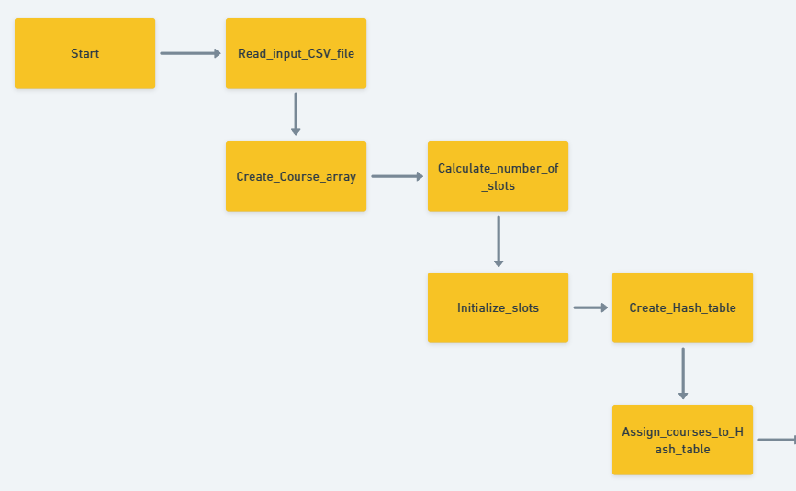

FLOWCHART

Slide 11
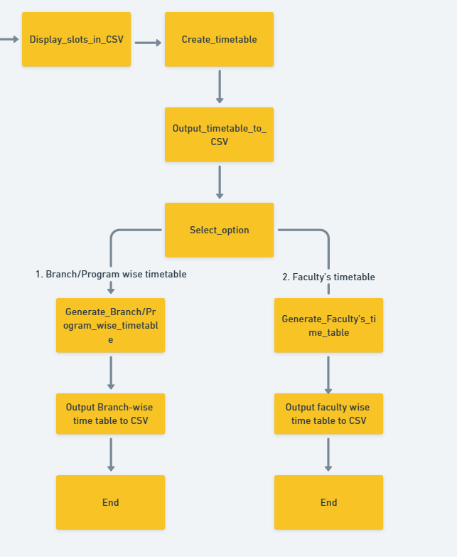

Slide 12
Data Structures Chosen
Arrays: To store the courses , course code , faculty , lecture-count , semester , array of courses, slot, and for storing number of different faculties in temp_array.
Hash Table: To store courses on bases of available programs.
Priority Queue: For printing the slots for timetable where priority is assigned to the slots.
Linked List: used for implementing Hash Tables.

Slide 13
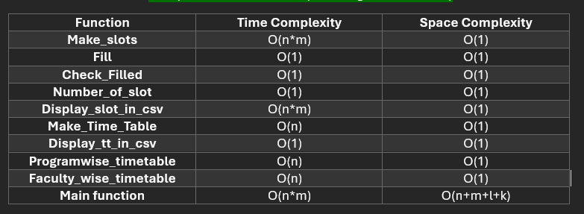
Analysis of Time and Space Complexities

Slide 14
Link to the Video
https://www.youtube.com/watch?v=MJ2yF9tjZ8E

Slide 15
"Thank You"

